Slide 1
1.GOPIKA
2.HEMALATHA

Slide 2
INDEX

Slide 3
CONTENT
Index Overview
Types of Index
Index Characteristics
Performance Impact
Index Rebuild

Slide 4
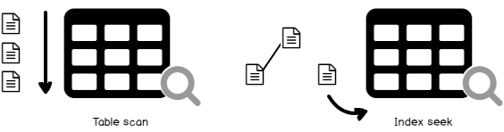
Index Overview
An Index is the structure or object by which we can retrieve specific rows or data faster.
Index will create a pointer to the actual rows in the specified table.
Indexes can be created using one or multiple columns depending on query requirement conditions.
An index helps to speed up SELECT queries and WHERE clauses but it slows down data input, with UPDATE and INSERT statements.
Indexes can be created or dropped with no effect on the data.
WITHOUT INDEX WITH INDEX

Slide 5
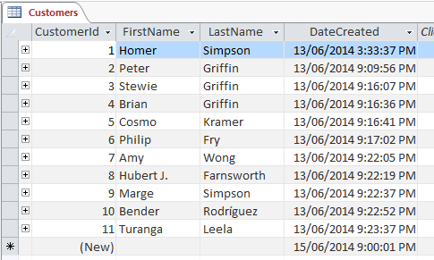
Without index finding a data will use total table scan
Index will directly point data and it will be sorted in manner

Slide 6
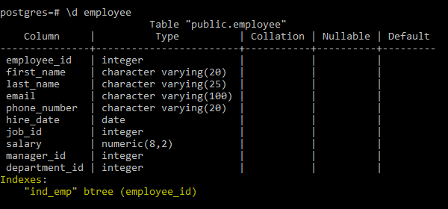

Index Overview
Syntax for creating an index:
CREATE INDEX index_name ON table_name (column_name);
Syntax for dropping an index:
DROP INDEX index_name;

Slide 7
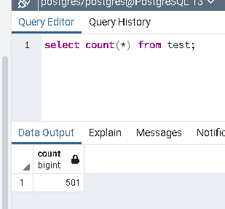
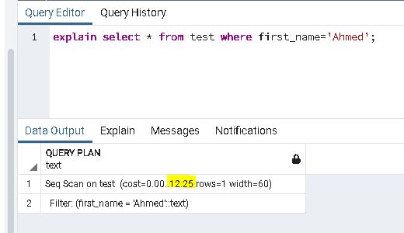
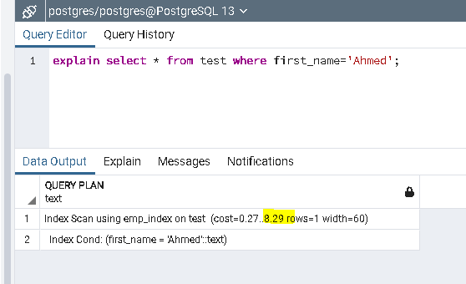
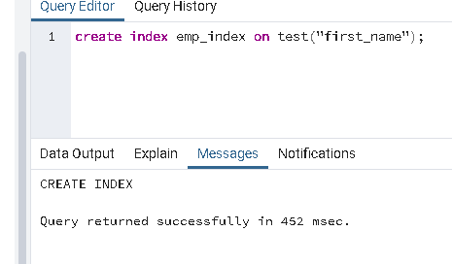
Index Overview
New table
Without index
With index
Index created
Retrieving data is fast by using index.

Slide 8
Type Of Index
Types of Index in Postgres database:
B-TREE
When we create an index, the B-Tree serves as the default.
The B stands for balanced, meaning that the tree-shape of the index focuses on having the same amount of data on both sides.
Mostly used for datatypes and queries
Syntax: CREATE INDEX name ON table USING BTREE (column);
.HASH
Hash indexes can handle only simple equality comparison (=),which means we can only look up for data that matches exactly.
Syntax: CREATE INDEX name ON table USING HASH (column);
GiST(Generalized Search Tree)
GiST Index is useful when the data to be indexed is more complex than to do a simple equate or ranged comparison like finding nearest-neighbour and pattern matching.
The example of such data includes geometric data, network address comparisons and full-text searches.
Syntax: CREATE INDEX name ON table USING gist (column);

Slide 9
Type Of Index
SP GiST (Space-Partitioned GiST)
SP-Gist is non-balanced in nature and divides data in partitions.
For handling non-balanced structures (quadtrees, k-d trees, radix trees)
GIN( Generalized Inverted indexes)
Indexes are useful in indexing data that consist of multiple elements in a single column such as arrays, json documents (jsonb) or text search documents (tsvector).
BRIN(Block Range Indexes)
BRIN allows the use of an index on a very large table.
The BRIN index divides the table into block ranges and keeps a summary of those blocks. This summary includes min, max values of the range.

Slide 10
B-Tree
B-Tree structure, which consists of three main levels:
The top or Root level nodes
The nodes located between Root and Leaf levels are termed as Intermediate level nodes.
The bottom level or Leaf level nodes
B-tree index type is suitable for sorted data.
The indexed column is used to perform the comparison by using comparison operators such as <, <=, =, >=, and >, then the optimizer uses the index created by the B-tree option for the specified column.
Search by equality: We will search for a value in a tree for the condition "indexed-field = expression“
Search by inequality: Searching by the condition such as "indexed-field ≤ expression" (or "indexed-field ≥ expression")
Search by range: When condition is in the format "expression1 ≤ indexed-field ≤ expression2“.

Slide 11
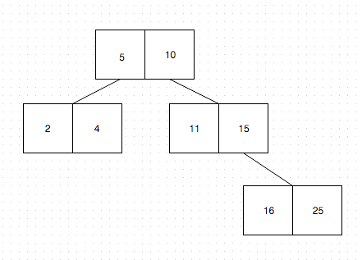
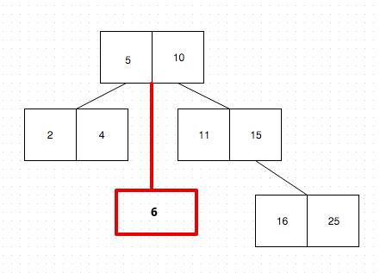
B- Tree
B-Trees have the concept of order, where for B-Trees an order of 3 means that each non-leaf node of the tree can have a maximum of 3 children, which means that each node can have two (3-1) keys. Here we have
one node, with values smaller than 5
one node, with values between 5 and 10
and one node, with values larger than 10

Slide 12
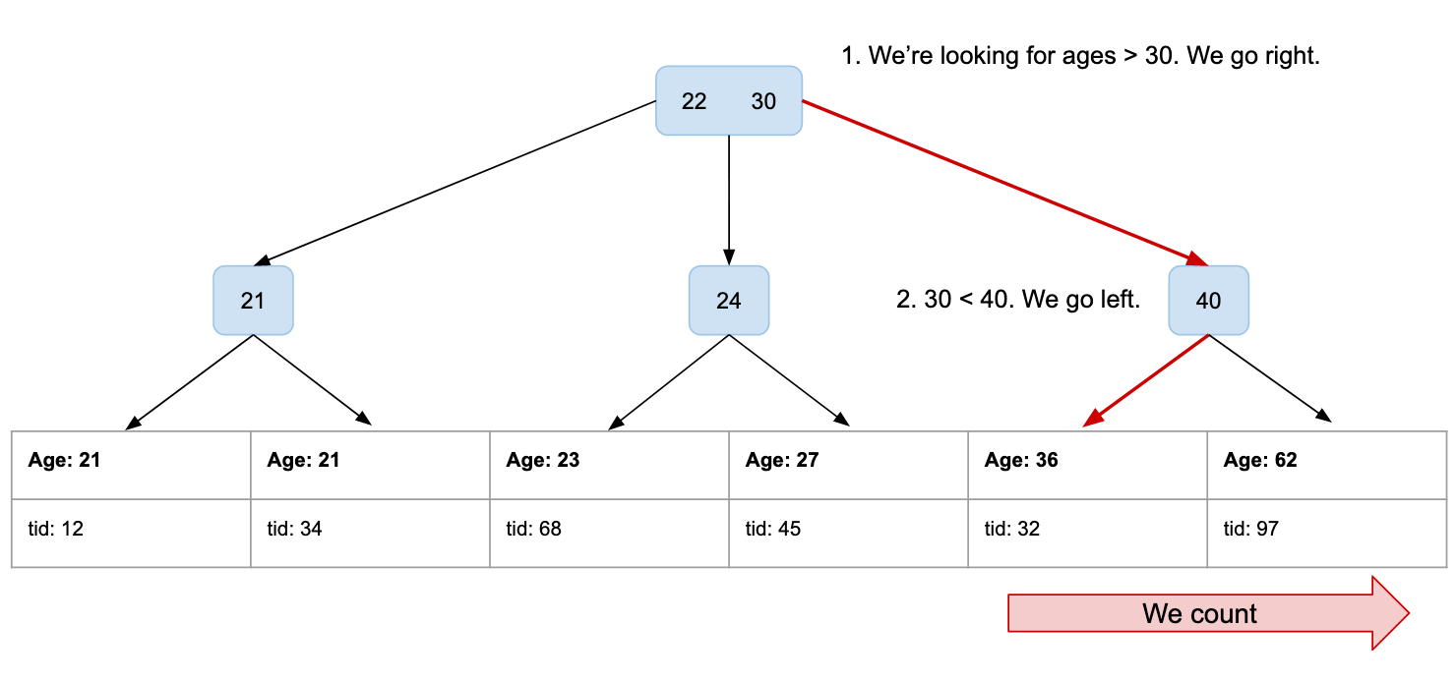
B-Tree
Root Node
Intermediate Node
Leaf Node

Slide 13
Index Characteristic:
Primary Key, Unique key columns already have indices by default.
Indexes are stored in B-Tree or Hash Tables most of the times, some databases only allow us options to specify which data structure to use.
Indexes are not good on the columns which are facing frequent Insert, Update, Delete operations. Because both columns and their corresponding indexes are updated each time.
Prefer indexes on columns which we are going to use more in WHERE clause.
Indexes are useful mostly in improving join performance.

Slide 14
Performance Impact
Some of the factors that define the performance impact when creating index are
Table Size
It is not recommended to create indexes on small tables, since it takes less time scanning the underlying table than traversing the index when searching for a specific data. In that case, the index will not be used and still affect the data modification performance, as it will be always adjusted when modifying the underlying table’s data.
Table Columns
When we choose columns for index, it is appropriate to select columns which have UNIQUE and NOT NULL values are considered optimal columns to participate in the index key.
Columns Order and Sorting
When designing an index, consider the columns that participate in the index key should be sorted in ascending or descending order, with the ascending order as the default order, depending on the system requirements.

Slide 15
Performance Impact
Pros: Reduces time taken for retrieving the data. Reduces the amount of data to read during the retrieval of data. Indexed data will be in sorted order so no need of sorting data externally.
Cons: Additional space is used in database as index creates a new table. Indexes slow down the process INSERT,UPDATE and DELETE, because on each operation the indexes must also be updated.
Obviously keeping several different indices has a negative impact on insert and
delete performance.

Slide 16
Index Rebuild
What is index rebuild?
Rebuilding an index drops and re-creates the index. This removes fragmentation, reclaims disk space by compacting the pages based on the specified or existing fill factor setting in a single transaction.
Fragmentation can be of two types:
Gaps in data pages – this creates wasted empty space.
Logical fragmentation – this is a logical ordering of the data that no longer matches the physical ordering of the data
The only way to remove wasted space and logical fragmentation is to rebuild or reorganize the indexes on a regular basis.

Slide 17
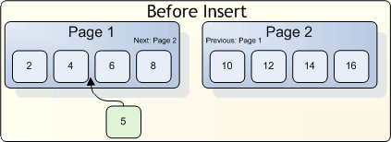
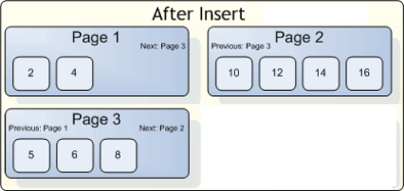
Index Rebuild
Logical fragmentation:
Suppose we need to insert new row with a primary key of ‘5’
since it is a clustered index, the new row must be inserted in order.
Because the page1 is fully filled new row does not fit, server splits the page roughly in half and inserts the new data on the new page, as shown in the following figure.
logical order of the index does not match the physical order, and the index has become fragmented.

Slide 18
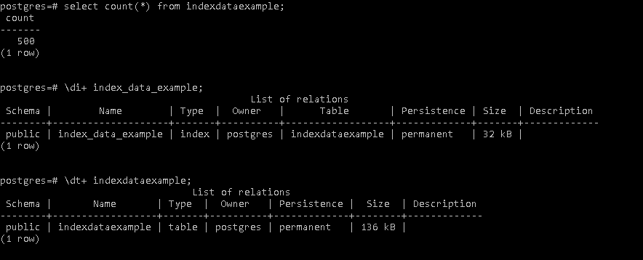
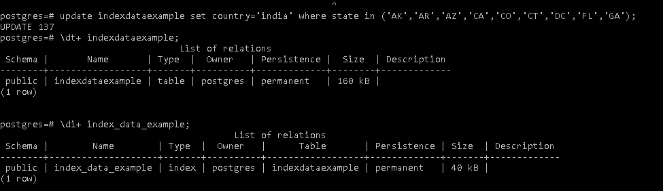
Index Rebuild
Initial data
After update
© Elait Limited. Confidential

Slide 19
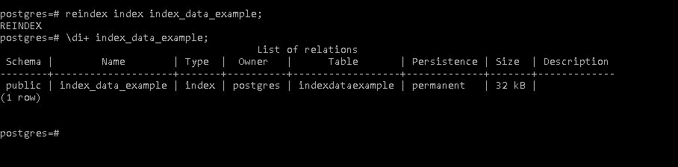
Index Rebuild
After rebuild index
SYNTAX: REINDEX INDEX (index_name);
© Elait Limited. Confidential

Slide 20
Index Reorganization
What is index Reorganization?
Index reorganization is a process where the SQL Server goes through the existing index and cleans it up.
When to use Rebuild/Reorganization?
Fragmentation less than 10% is negligible, performance impact will be minimal.
Fragmentation is in the range of 10-30%-----use reorganization
Fragmentation is higher than 30% ------------Use rebuild
Fill Factor: Fill Factor is a percentage value to be filled data page with data in SQL Server
Fill factor value defined with 80 on Primary Index means that each page of table will have 20% free space and 80% space will be allocating to store the data and this free space used during update and insert.
Syntax with fill factor:
CREATE INDEX <INDEX_NAME> on <TABLE_NAME>(COLUMNS) with (FILL FACTOR=80)

Slide 21
THANK YOU

